Slide 1
Evaluating AI Models for Business Name Detection in Mobile Databases
Syed Javed Professor: Dr. Weifeng Xu College of Public Affairs, University of Baltimore
Introduction
Internship: Spring 2026
Focus: Digital forensics and artificial intelligence
Task: Detect business names in mobile database data

Slide 2
INTRODUCTION (PROBLEM CONTEXT)
Digital forensic investigators analyze mobile application databases to find important information such as:
Business names
Organizations
Communication records
Manual database analysis is:
Time-consuming
Labor-intensive
Difficult to scale
Identifying business names is a type of:
Named Entity Recognition (NER) [1]

Slide 3
BACKGROUND & RESEARCH
Named Entity Recognition (NER) is a common task in natural language processing [1]
Large Language Models (LLMs) can perform NER tasks [3]
Performance depends on: [2]
Data quality
Data structure
Research findings: [2]
AI works well on clean text
AI struggles with structured and noisy data

Slide 4
OBJECTIVE
Project Objective
Evaluate how accurately AI models can identify business names
Use mobile database data as input
Compare AI results with manually created ground truth

Slide 5
DATASET
Seven mobile forensic databases were analyzed:
A1_msgstore.db
I1_ChatStorage.sqlite
A1_wa.db
I3_sms.db
I4_CloudTabs.db
I4_History.db
A5_SBrowser.db
Each database was converted into a CSV file for analysis

Slide 6
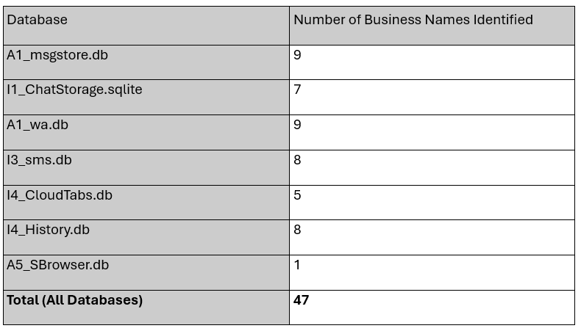
GROUND TRUTH
Ground Truth Creation
Business names were manually identified by:
Opening each database file
Searching tables, columns, and rows
Recording all visible business names
A ground-truth TXT file was created for each database
Total business names identified: 47

Slide 7
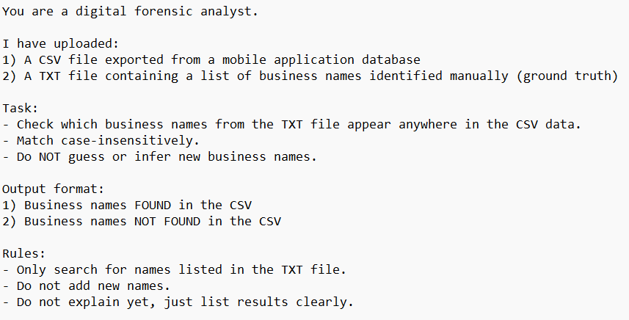
AI MODELS TESTED
Prompt (Instructions):
AI Models Evaluated
ChatGPT GPT-5.3
Grok 4
Microsoft 365 Copilot GPT-5
All models received:
Same CSV files
Same ground-truth lists
Same instructions

Slide 8
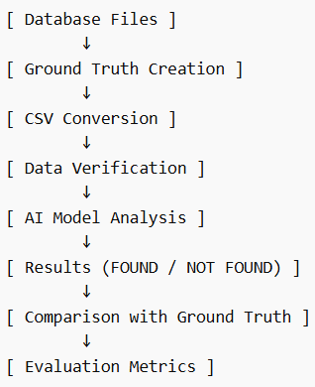
METHODOLOGY (WORKFLOW)
Short Workflow:
Methodology Steps
Open and manually analyze database files
Create ground-truth list of business names
Convert database into CSV format
Verify ground-truth names exist in CSV
Provide CSV and ground truth to AI models
AI models check names (FOUND / NOT FOUND)
Compare results with ground truth
Calculate evaluation metrics

Slide 9
EVALUATION METRICS
Evaluation Metrics
Precision
Formula: TP / (TP + FP)
Meaning: When the AI says it found a name, how often is it correct?
Recall
Formula: TP / (TP + FN)
Meaning: Out of all real business names, how many did the AI find?
F1 Score
Formula: 2 × (Precision × Recall) / (Precision + Recall)
Meaning: Balance between precision and recall
Accuracy was not used due to lack of true negatives

Slide 10
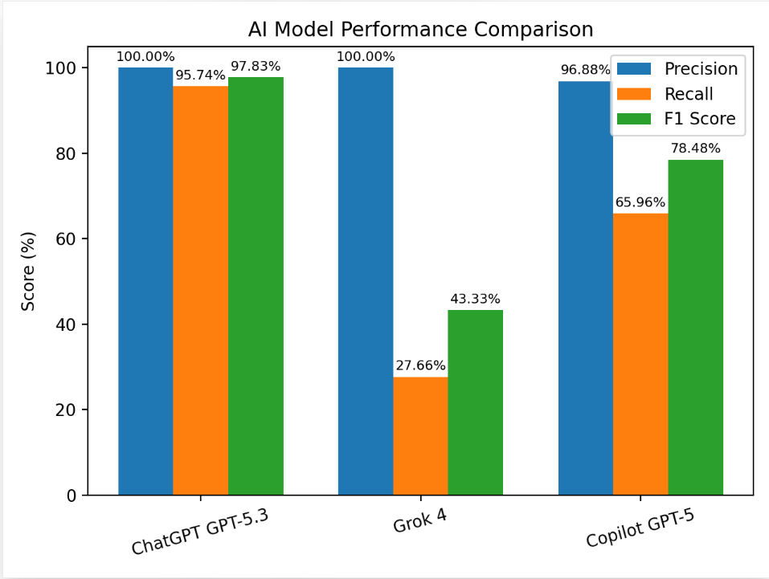
RESULTS
Model Performance Comparison
ChatGPT GPT-5.3:
Best overall performance
Grok 4:
High precision
Low recall
Copilot GPT-5:
Moderate performance

Slide 11
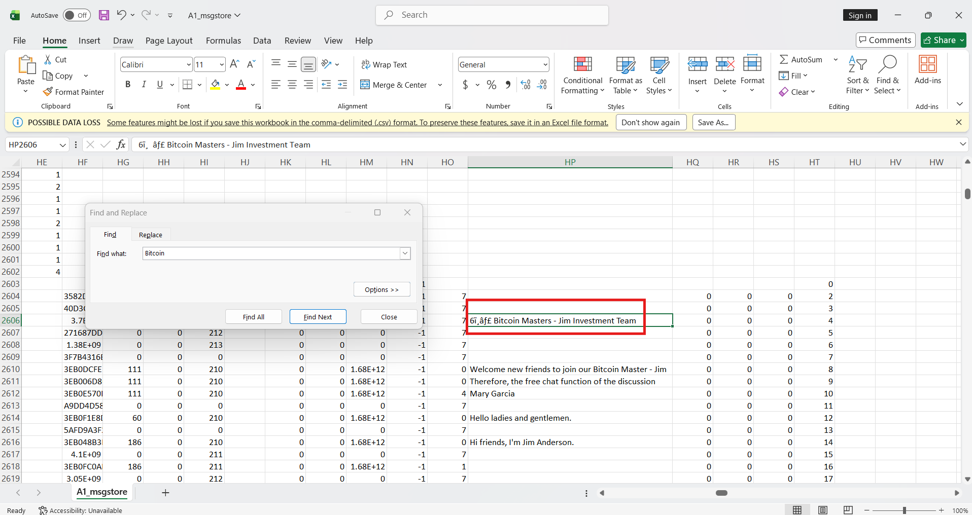
ERROR ANALYSIS
Ex: A1_msgstore.csv
Reasons for Errors
Conservative detection (high confidence only)
Noisy and unstructured database data
Large CSV files causing missed entries
Formatting and encoding differences
Research shows LLMs struggle with structured and domain-specific data

Slide 12
FUTURE WORK
Data Improvements
Clean and normalize CSV data
Split large files for better processing
Alternative Data Formats
Convert database data into:
JSON (structured, key-value format) [4] [5]
TOON (compact format optimized for AI) [4] [5]
Why This Matters
Better structure improves AI understanding
TOON reduces token usage (more efficient)
Potential for improved accuracy and lower cost

Slide 13
CONCLUSION
ChatGPT achieved the best overall performance
AI can assist digital forensic investigations
Model performance depends on:
Data quality
Model behavior
Data structure

Slide 14
REFERENCES
[1] S. Wang, Y. Liu, and Z. Chen, “GPT-NER: Named Entity Recognition via Large Language Models,” in Proc. Assoc. Comput. Linguistics (ACL), 2025.
[2] Y. Lu and Y. Huo, “Financial Named Entity Recognition: How Far Can Large Language Models Go?,” arXiv preprint arXiv:2501.02237, 2025.
[3] Y. Zhao, “Large Language Models for Named Entity Recognition: A Survey,” Artif. Intell. Rev., 2025.
[4] V. Sheth, “JSON vs TOON: The New Structure for Large Language Models,” Medium, 2025.
[5] A. Dugan, “TOON vs. JSON,” DigitalOcean Community Tutorials, Dec. 16, 2025.

Slide 15
GitHub Link
The following GitHub link has the results, ground truth, prompt, poster, and PPT slide:
https://github.com/syedj25/Evaluating-AI-Models

